Slide 1
Java Generics – Examples (Daily Work)

Slide 2
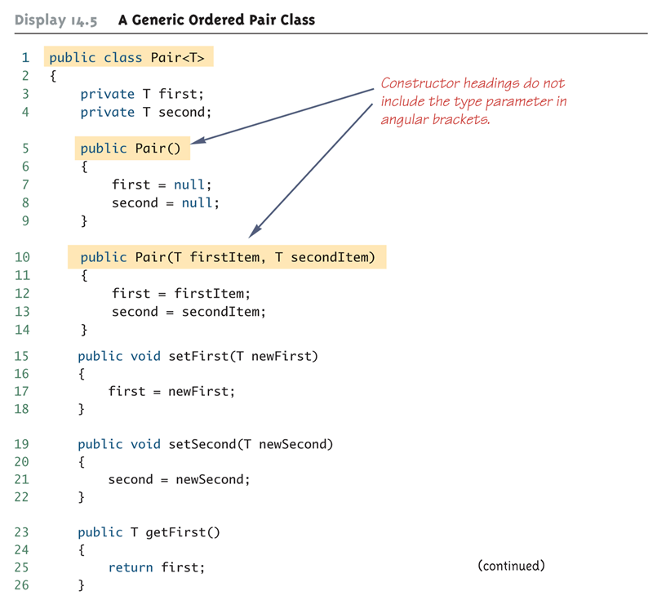
Generic Class Definition: An Example

Slide 3
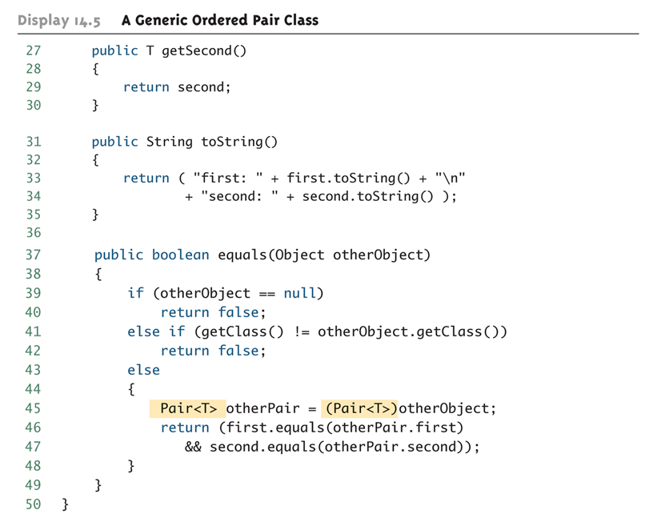
Generic Class Definition: An Example (Cont’d)

Slide 4
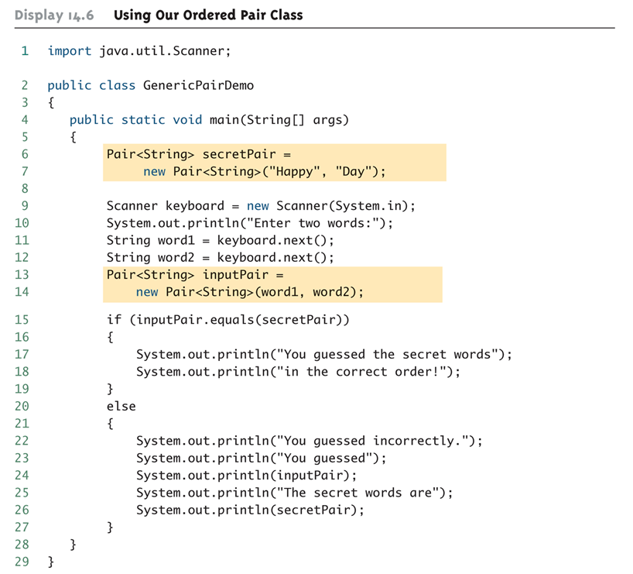
Generic Class Usage: An Example

Slide 5

Generic Class Usage: An Example (Cont’d)
Program Output:

Slide 6
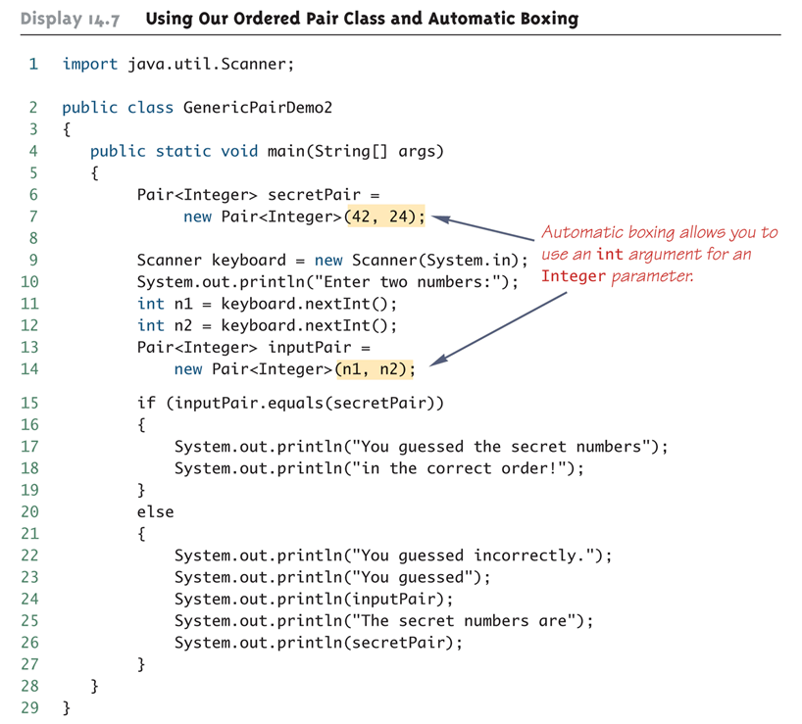
Using Generic Classes and Automatic Boxing

Slide 7
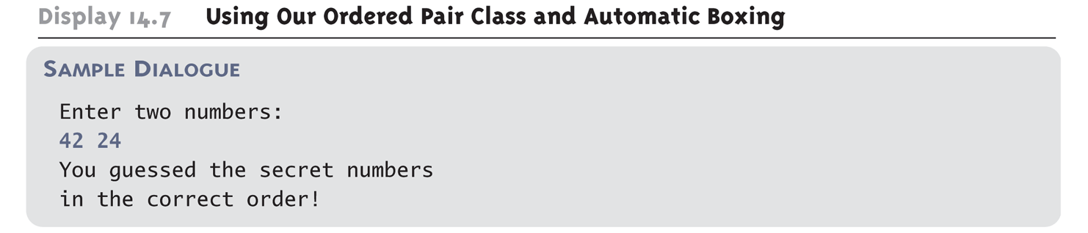
Using Generic Classes and Automatic Boxing (Cont’d)
Program Output:

Slide 8
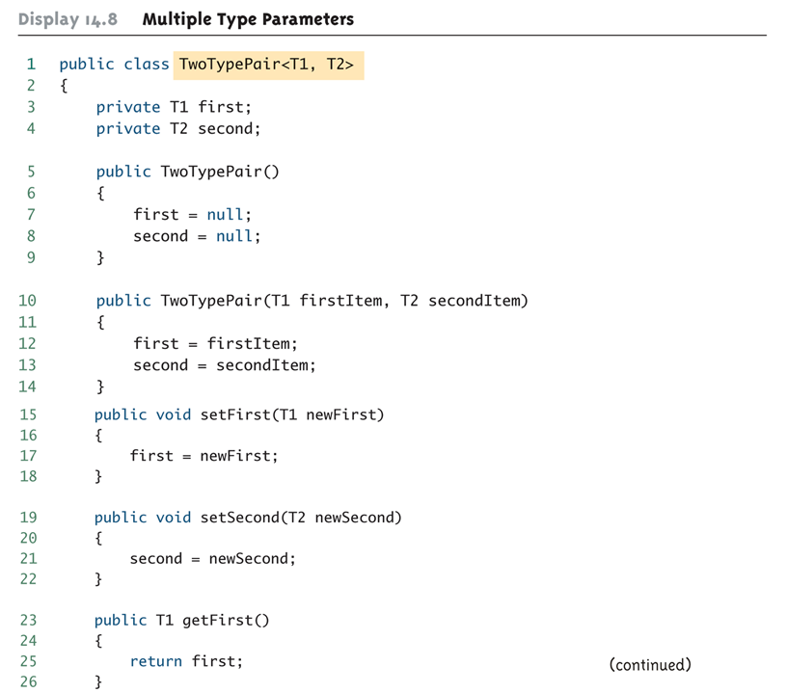
Multiple Type Parameters (Cont’d)

Slide 9
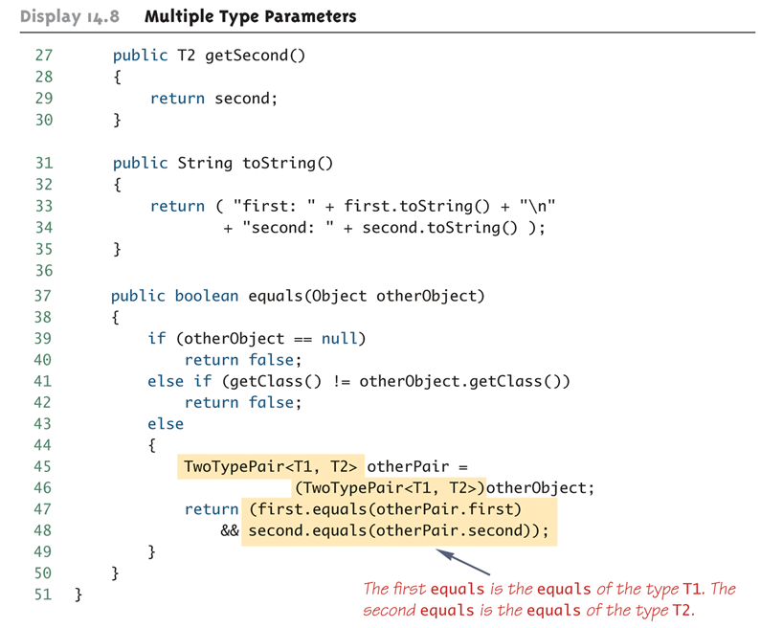
Multiple Type Parameters (Cont’d)

Slide 10
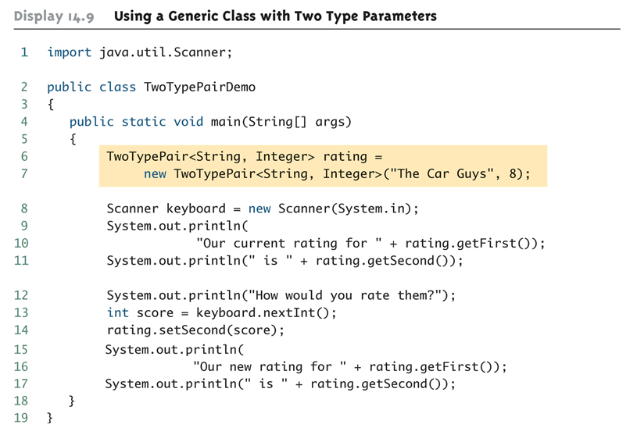
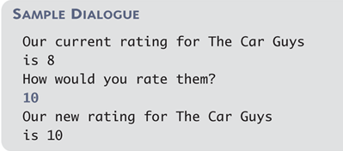
Using a Generic Class with Two Type Parameters
Program Output:

Slide 11
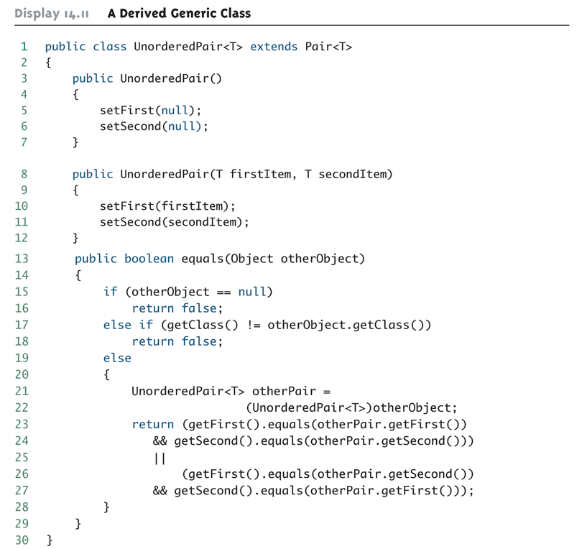
A Derived Generic Class: An Example

Slide 12
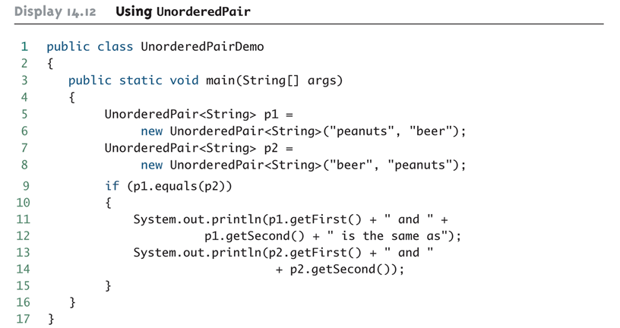

A Derived Generic Class: An Example (Cont’d)
Program Output:

Slide 13
Java Inner Classes - Example
Inner (or nested) classes are classes defined within other classes:
  The class that includes the inner class is called the outer class
There are four categories of inner classes in Java:
  Inner classes (non-static).
  Static inner classes.
  Local classes (defined inside a block of Java code).
  Anonymous classes (defined inside a block of Java code).

Slide 14
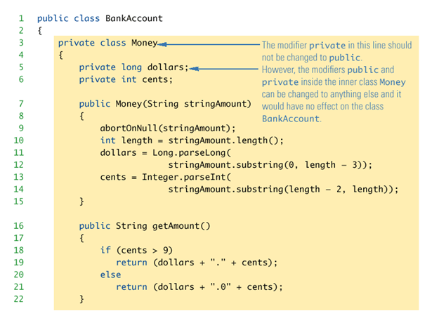
Example Program Inner Classes

Slide 15
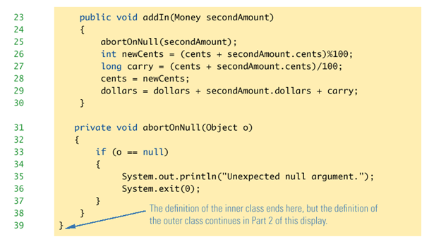

Slide 16
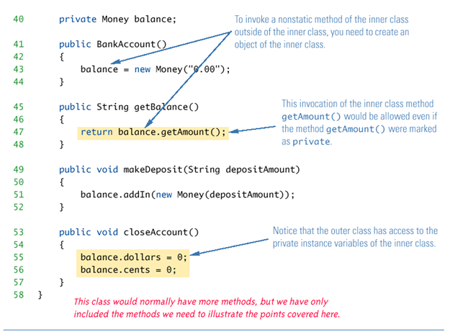

Slide 17
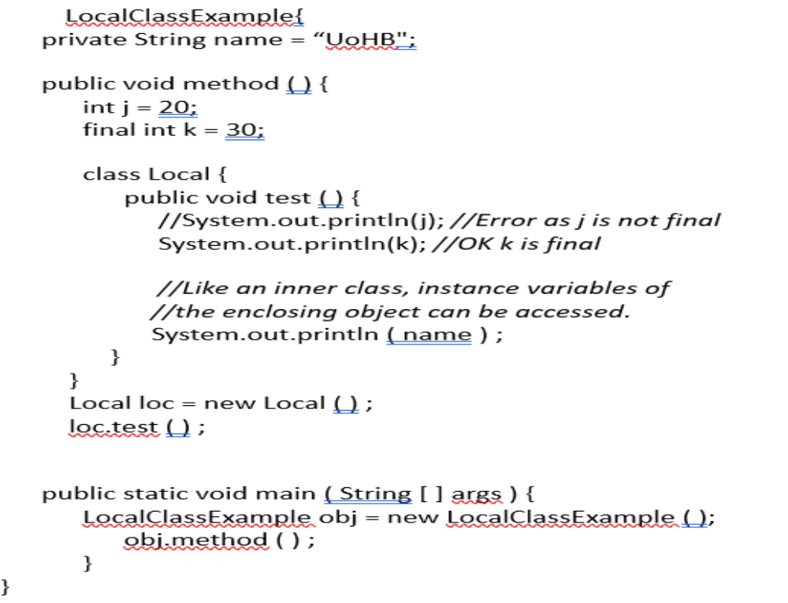
Local Class Example:

